Slide 1
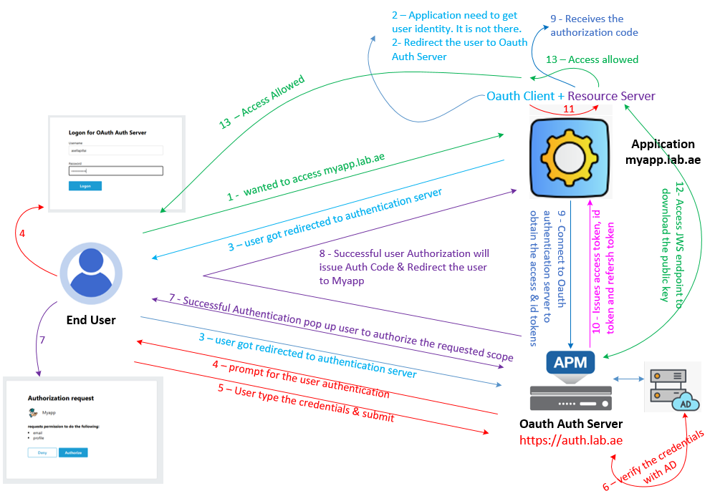

F5 APM Learning with Alexander S
Chapter 05 – Integrating the Oracle APEX application with F5 APM as the authentication server, using the OAuth Authorization Code flow

Slide 2
I highly recommend watching Chapter 02 and Chapter 03 first
Because they explain how F5 APM is implemented as an OAuth Authorization Server using the OpenID Connect Authorization Code Flow.
Which provides the essential background for this chapter.

Slide 3
Configuration Summary - F5 and Oracle APEX Configuration
Step 1: F5 Configuration
Create a new OAuth client application for Oracle APEX Myapp application.
Add the Myapp client application to the OAuth profile.
Step 2: Oracle APEX Configuration
Make sure Myapp application is working well using Local Authentication.
Step 3: OAuth Setup in Oracle APEX
Configure Web Credentials for oAuth. It is global configuration in Apex.
Create a new OAuth Authentication Scheme in Apex Myapp application.
Promote the new authentication scheme as the primary authentication method.
Step 4: Validation
Test the MyApp application using OAuth-based authentication

Slide 4
Step 01: Configure the F5 Client Application for Apex myapp application
Let us collect the below pre-requisites from apex team
1. Redirect URI
https://myapp.lab.ae:5000/ords/apex_authentication.callback
2. Scopes
Email & Profile
3. Logo URL for the stylish prompt
https://myapp.lab.ae:5000/ords/r/apex-prod/100/files/static/v10/icons/app-icon-192.png
Once all the pre-requisites are ready
We will configure the F5 client application configuration for APEX Myapp application.
Once the client application is configured - Add the newly configured client application into F5 oAuth Auth Profile.

Slide 5
Important note
On chapter 03, we have configured this Auth-Profile.
If you haven't watched chapter03, Please watch using the below link.
https://www.youtube.com/watch?v=c_5q1KwViA4

Slide 6
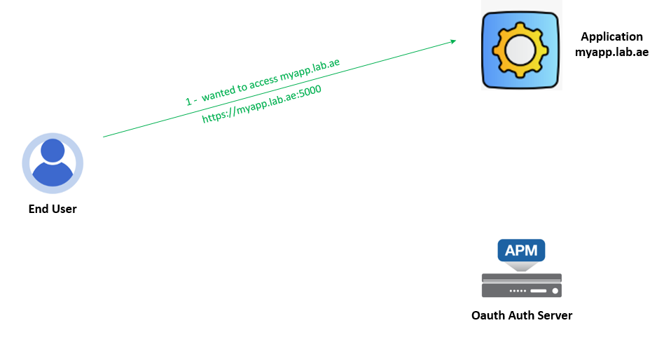
Step 02: Oracle APEX– Test the Myapp application from the client Machine
200 OK - With Response Content
To test this, RDP into the client machine and open the following URL in the Chrome browser:
https://apex.lab.ae:5000/ords/r/apex-prod/prod-calendar
This will open the application login page and prompt for authentication.
Enter the local user credentials and sign in.
✅ Success!
The application is working correctly using local authentication.

Slide 7
Step 03: Oracle APEX Configuration
Configure the Web Credentials in Apex for oAuth. Web Credentials configuration is a global configuration in Apex.
Workspace Sign in URL
https://apex.lab.ae:5000/ords/r/apex/workspace-sign-in/
Configure the OAuth Authentication Scheme in Apex-Myapp application using those newly created web credentials
Open ID discovery end point
https://auth.lab.ae/f5-oauth2/v1/.well-known/openid-configuration
To know more about this watch this video – Watch Chapter 04
https://www.youtube.com/watch?v=OJcYktZGj0s
Promote the new Authentication scheme as active authentication method for Apex Myapp application

Slide 8
Step 04: Test the Myapp application using OAuth-based authentication
To test this, RDP into the client machine and open the following URL in the Chrome browser:
https://myapp.lab.ae:5000/ords/r/apex-prod/prod-calendar
Great - It is redirected the user into F5 APM login page.
Enter the AD user credentials and click logon.
The successful Login prompt you for the Authorization.
Here click authorize. Awesome!!! We logged in to Apex Myapp application using oAuth.
Here you will see email used as username for the login. Which we have confirmed it Apex Authentication scheme.
The application is working correctly using oAuth authentication.

Slide 9
Chapter 05 – Integrating the Oracle APEX application with F5 APM as the authentication server, using the OAuth Authorization Code flow
In this chapter, we successfully integrated the Oracle APEX application with F5 APM as the authentication server, using the OAuth Authorization Code flow.
With this, we wrap up the F5 APM Learning Series – OAuth Code Flow.
Thank you for watching and supporting the series!

